Slide 1
BERT
Bidirectional Encoder Representations from Transformers

Slide 2
BERT:
Deep learning model for NLP pretraining
Developed by Google
BERT went live 24th Oct 2019
Yet to rollout for other countries and languages
Fairly new model
For now, BERT is live for
General ranking in US English
Featured snippets for 25 languages

Slide 3
What was the problem?
We do a Google Search –
Don’t know the best way to formulate a query
Don’t know right words
Don’t know how to spell something
Search a topic to learn – essentially don’t have knowledge to begin with!
Ask a question that comes natural to us.
Enter keywords and not sure how to formulate.
Google Search is expected to return apt results for what we are looking for!
Google wants to improve its search results

Slide 4
How Google solved the problem?
Introduced a neural network based NLP technique called BERT.
BERT does a much better job at finding useful information.
Applied to ranking and featured snippets.
How? Uses Transformers that understands a word w.r.t other words in a sentence, rather than one-by one order.

Slide 5

Example 1

Slide 6

Example 2

Slide 7
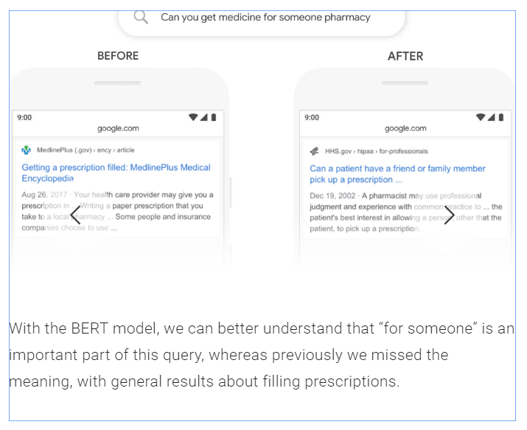
Example 3

Slide 8
Team behind BERT
Jacob Devlin
Ming Wei Chang
Kenton Lee
Kristina Toutanova

Slide 9
How does it solve the problem?
Transformer
MLM Masked LM
NSP Next Sentence Prediction

Slide 10
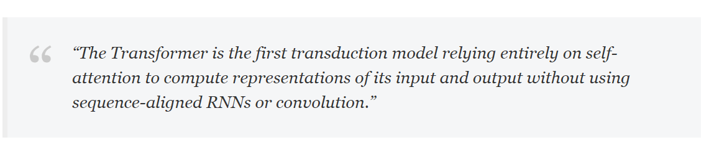
Transformer
What is a transformer?
Quote from the paper – Attention is all you need!
Transduction here means conversion of input sequences to output sequences.
Important point here is Attention!

Slide 11
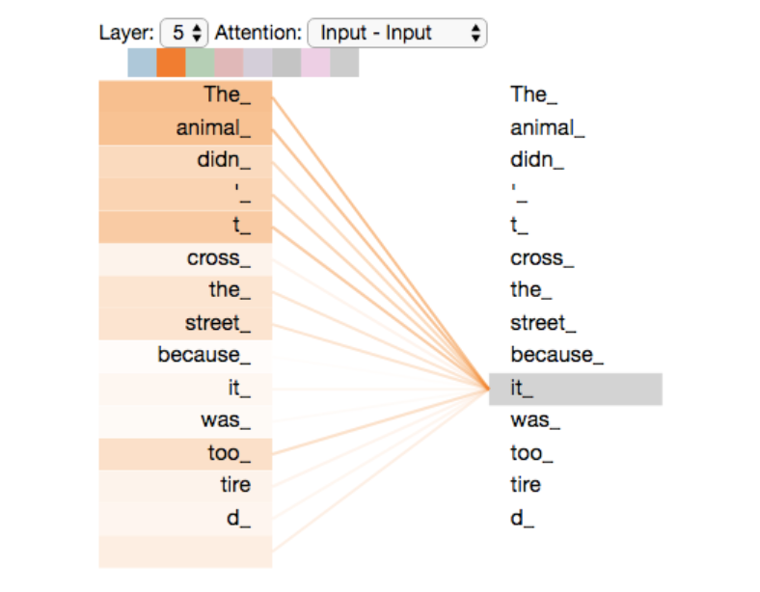
Self Attention?
While encoding a word, Self attention will look at each word to understand the relevance of that word with the one we are encoding.
Strong connections with most relevant words.
While encoding, embed/bake the information of relevant words into that word.
Encoded word-package of that word with its relevant words.

Slide 12
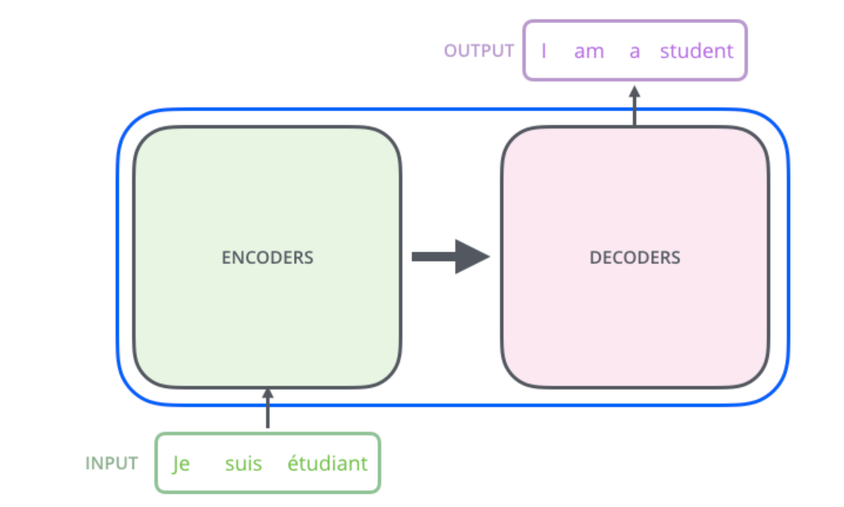
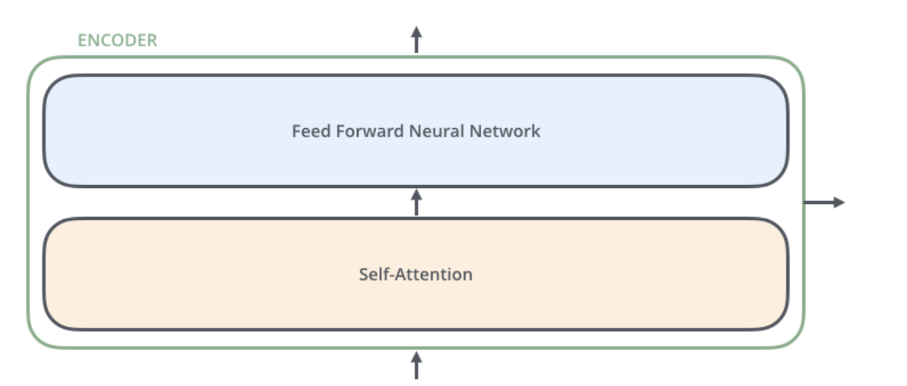
Transformer
Has encoder and decoder
Since BERT uses encoder, lets focus on the encoder unit.
Encoder has
Self Attention Unit
Feed forward Neural Network
Focus on Self Attention layer!

Slide 13
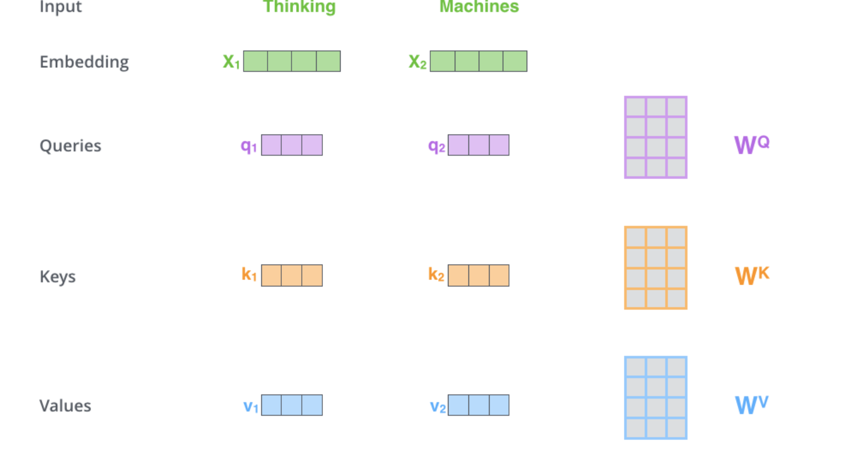
Self Attention in Transformer
Create 3 vectors from encoder’s input vectors
Query
Key
Value
Multiplying input with Wq,Wk,Wv to get Q,K,V respectively.
Wq,Wk,Wv trained across the network

Slide 14
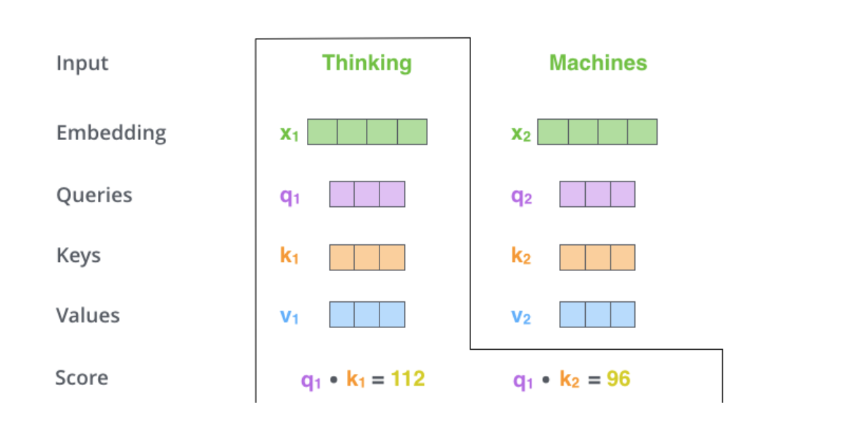
Next Steps
Calculate score
Scoring each word in the sentence against the word in consideration.
Weighting each words relevance w.r.t the word under consideration.
Score is dot product of query vector Q of the word to be encoded with Key vector of other words in the sentence.

Slide 15
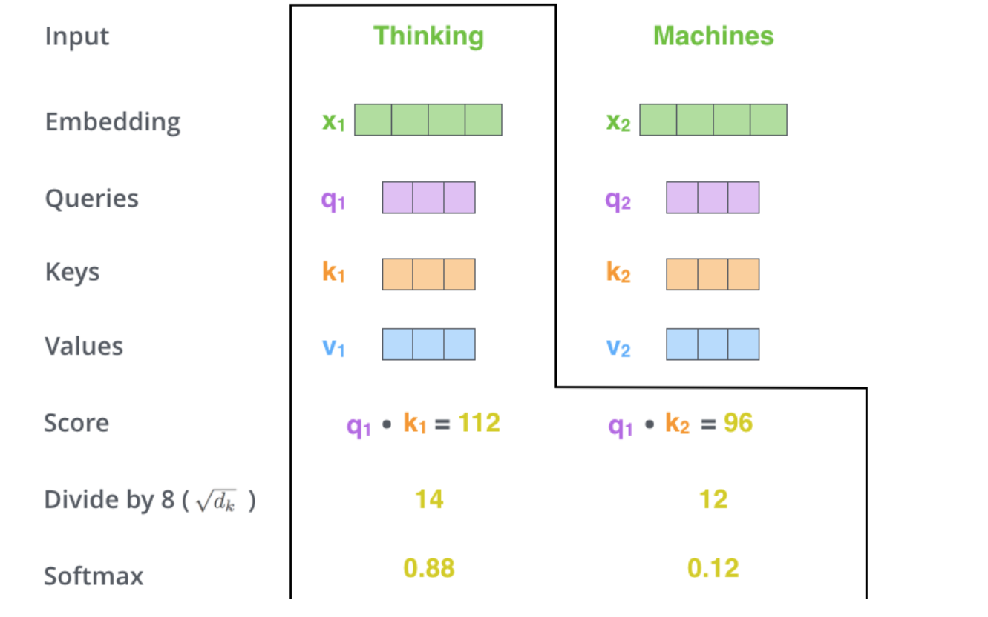
Next Steps
Divide the scores by the square root of the dimension of the key vectors.
Leads to having more stable gradients
Then do a SoftMax.
Normalizes the scores so they’re all positive and add up to 1

Slide 16
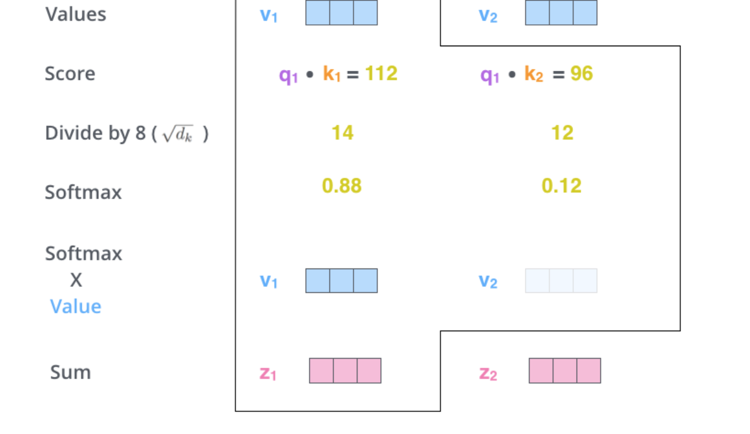
Next Steps
Multiply each value vector by the softmax score
Keep the values of the words that we want to focus on, drown out other irrelevant words.
Then sum up the weighted value vectors
This is our first encoded word!

Slide 17
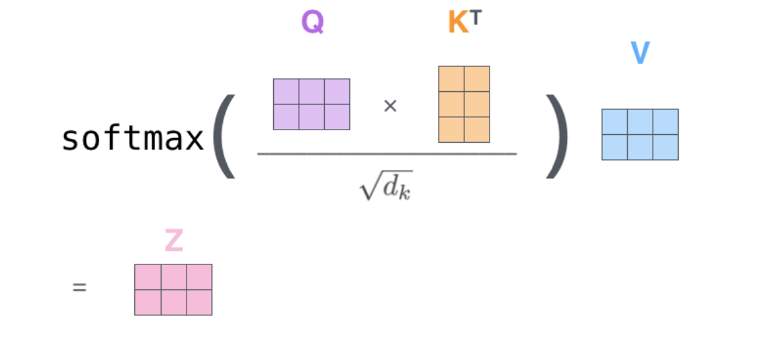
Happens in matrix form and a few steps
Useful for BERT:
With one encoded word, you have all the relevant context from left as well as right of the sentence at the SAME time.
Hence, using transformers, we get high accuracies.

Slide 18
Masked LM
Model can be trained as -
Give a sequence of words, ask model to guess the next word-Left To Right!
“Which Sesame Street” predict the next word.
Good if want to predict sequences!
Bidirectional LSTM LM :
One LSTM trains model Left to right
Other LSTM trains model right to left
Issue – doesn’t consider left context and right context of a sentence at the same time!
Example-”The Cat sat on the Mat”

Slide 19
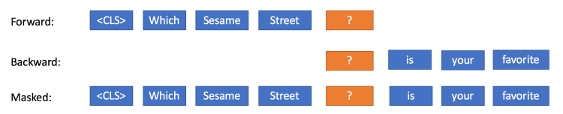
Masked LM:
Masked LM :
Mask a word and ask the model to predict that word.
More formally, given a context, a language model predicts the probability of a word occurring in that context.
Example : “The _____ sat on the mat”.
Model takes into account the entire context of the sentence to predict a word.

Slide 20
MLM in BERT
80% of the time: Replace the word with the [MASK] token
my dog is hairy !
my dog is [MASK]
10% of the time: Replace the word with a random word,
my dog is apple
10% of the time: Keep the word unchanged,
my dog is hairy.

Slide 21
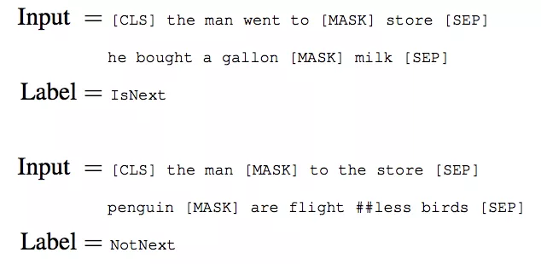
Next Sentence Prediction
Predict relationship between two sentences.
Sentence A and B. Is sentence B the actual next sentence that follows A?

Slide 22
NSP in BERT
BERT fed with two sentences during training.
50% of the time – Actual next sentence
Other 50% of the time – Random sentence
Asked to predict if the next sentence is the actual next sentence or random sentence.
Importance -Captures relationship between two consecutive sentences. Good for QA, NLI models

Slide 23
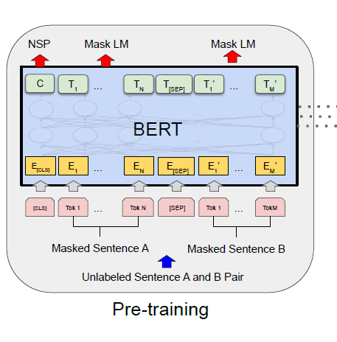
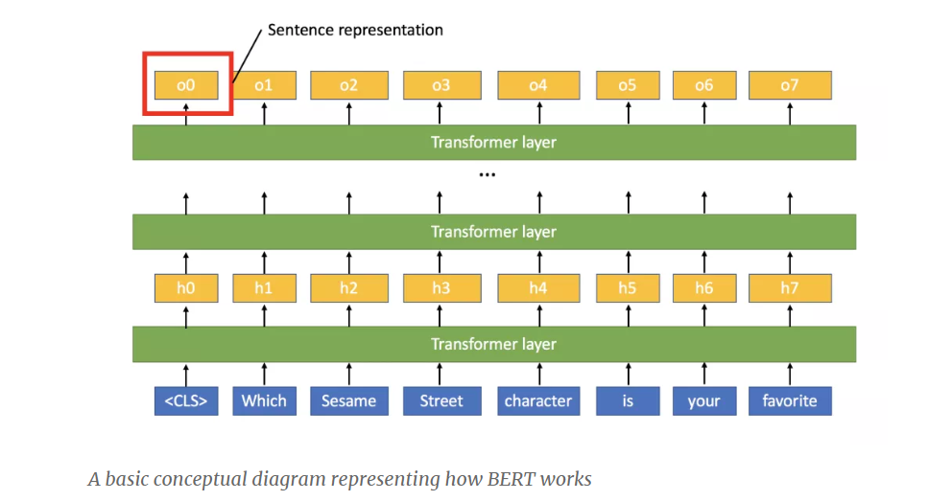
BERT Architecture BERTBase ( L=12, H=768, A=12, Total Parameters=110M) BERTLarge ( L=24, H=1024, A=16, Total Parameters=340M)

Slide 24
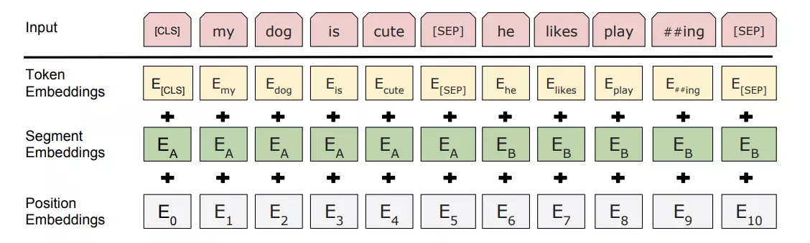
Input / Output Representations
[CLS] –Always First token of every sequence.
[SEP] – Sentences Separator token
Token Embeddings: Embed each token
Segment Embedding:
Label given to each sentence for model to differentiate sentences
Hard to learn for transformer from the [SEP ] tokens.
Position Embedding:
Position assigned to each word.
Hard for transformer to guess relative positions of the words.

Slide 25
Input / Output Representations and Pretrained Data
Uses word piece embeddings
Hence size of vocabulary decreased from M words to 30,522
Corpus used for pretraining
BooksCorpus(800M words)
Wikipedia(2,500M words)
extract text passages
Ignore tables, lists, headers

Slide 26
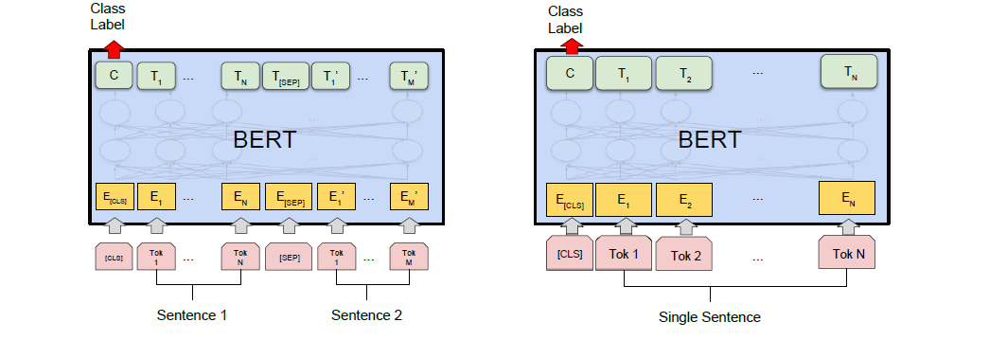
Output representations
Input and Output – 512 units
Classification Task: Take the CLS output(C)
Other tasks: Use other outputs

Slide 27
Code and hyperparameters
Code
https://github.com/google-research/bert/blob/master/modeling.py
https://github.com/google-research/bert
Pretraining:
Sequence length (single example): 256
Batch size: 512
Training steps: 1,000,000 (Approximately 40 epochs)
Optimizer: Adam
Learning rate: 1e-4
Learning rate schedule: Warmup for 10,000 steps, then linear decay
Dropout: 0.1
Activation function: gelu (Gaussian Error Linear Unit)

Slide 28
BERT Training Procedures
Pretraining
Fine tuning
Feature Based Architecture

Slide 29
Pretraining
Trained over unlabeled data over following tasks
Masked LM
NSP
Pre-training is fairly expensive.
BERT Base - 4 TPUs in pod configuration(16 TPU chips total)
BERT Large 16 TPUs (64 TPU chips total)
Took 4 days each to pretrain base and large.
One-time procedure for each language (current models are English-only, but multilingual models will be released in the near future).
NLP tasks no need to pretrain from scratch.

Slide 30
Fine tuning
Task specific Tuning
Plug In task specific input and outputs to the model along with task specific layers on the top.
Gently Fine tune the entire model.
Trained over labeled data
First initialized with the pre-trained parameters.
Relatively inexpensive – State of the art performance achieved just by training for 1 hr on a Google Cloud TPU.

Slide 31
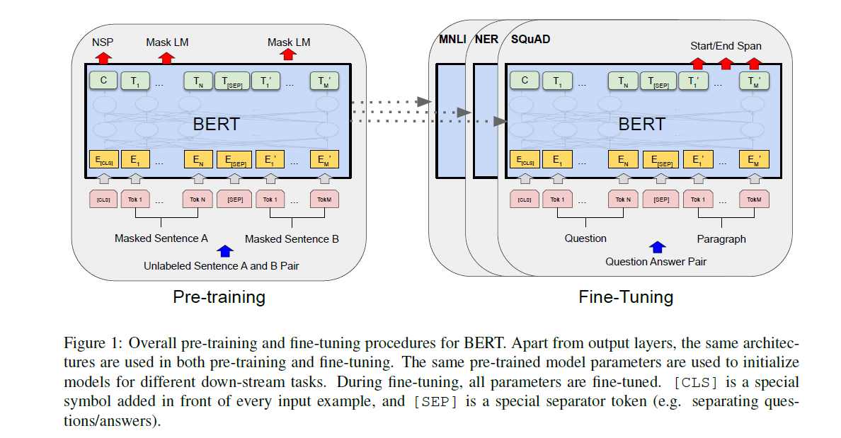

Slide 32
Feature Based
Have a BERT pretrained model
Have task specific neural network layers on top of it.
Use the BERT models parameters as-is. Ie you are extracting fixed features from the model
Only train the task specific layers
Benefits-
If computational power is limited, then feature extraction is a good choice
Gets just little less accuracy compared to fine tuning

Slide 33
Applications
11 applications giving state of the art performance.
Categorized as
Sentence Pair Classifications Tasks
Single Sentence Classification Tasks
Question Answering Tasks
Single Sentence Tagging Tasks

Slide 34
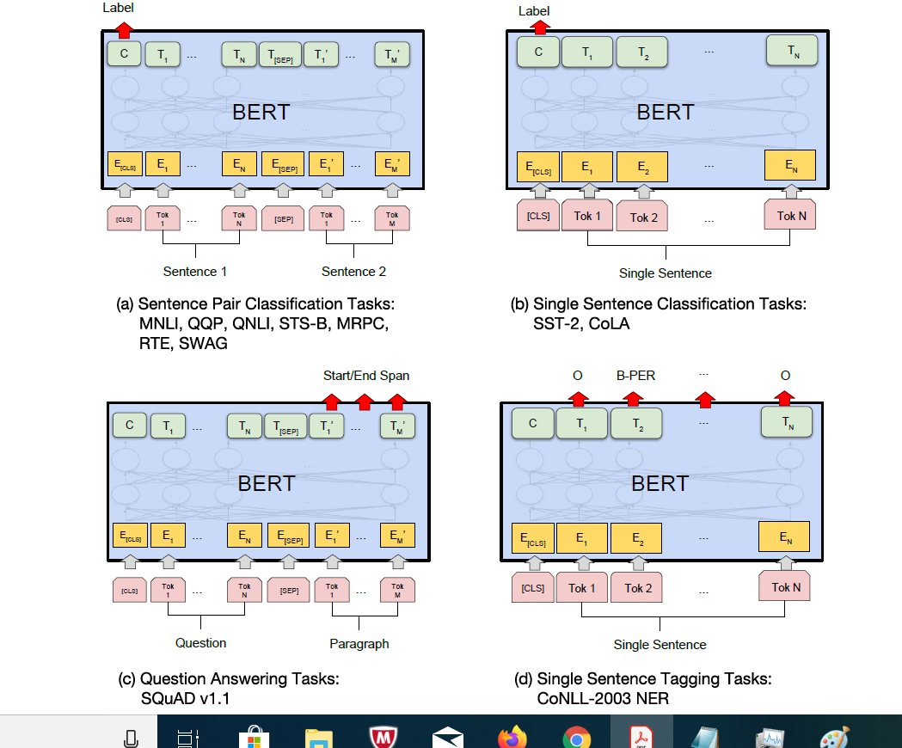

Slide 35
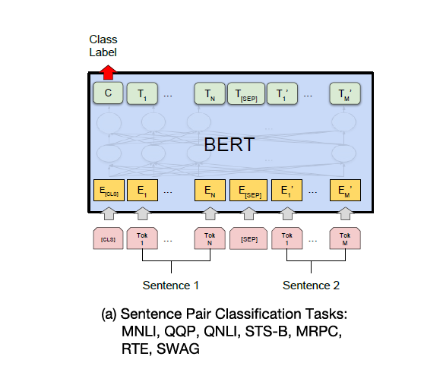
Sentence Pair Classifications Tasks MNLI- Multi-Genre Natural Language Inference
Large-scale, crowdsourced entailment classification task
Given a pair of sentences, the goal is to predict whether the second sentence is an entailment, contradiction, or neutral with respect to the first one
BERT with additional Layers
Output from cls since classification
512 embedding pass it through a layer logistic regression
512 weights to learn
3 classifications to perform
Fine tuning entire model.

Slide 36
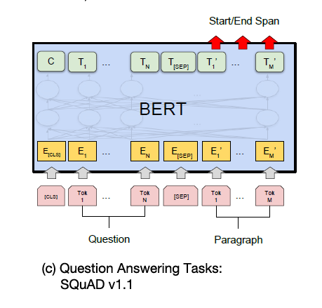
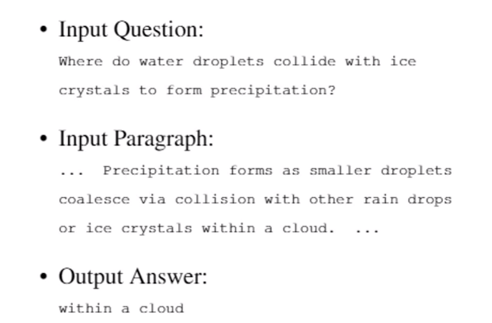
Question Answering Tasks-SQUAD

Slide 37
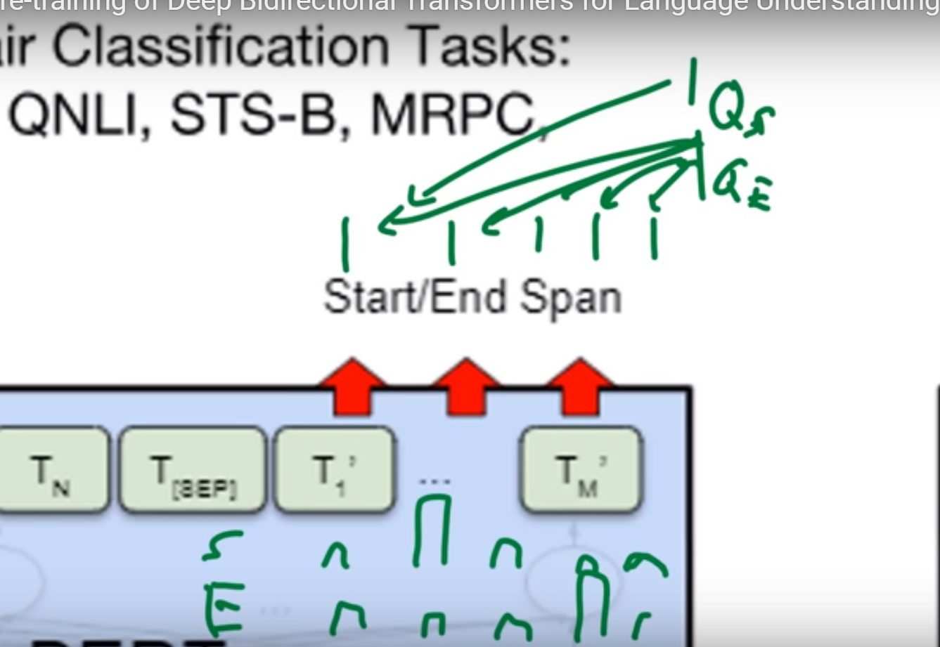
SQUAD
Predict the span(start and end of answer)
For each output, we classify it.
Is this the Start token?
Is this the end token?
Each output is a vector.
Have two queries-Qstart and Qend
Compute inner product of output vector with Qstart and Qend.
Get Distribution of probabilities of start and end pos
Qstart and Qend are learned.

Slide 38
Other Applications:
Single Sentence Classification Tasks-CoLA
Goal is to predict whether an English sentence is linguistically “acceptable” or not
QQP Quora Question Pairs
Binary classification task
Goal is to determine if two questions asked on Quora are semantically equivalent

Slide 39
Ablation Studies
Different Masking Procedures
Effect of pretraining tasks
Masked LM
NSP
Effect of model size
Feature Based Approach

Slide 40
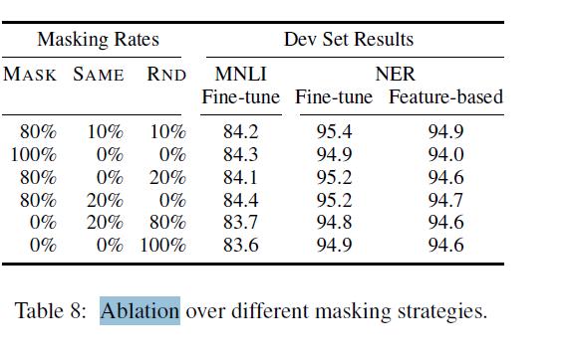
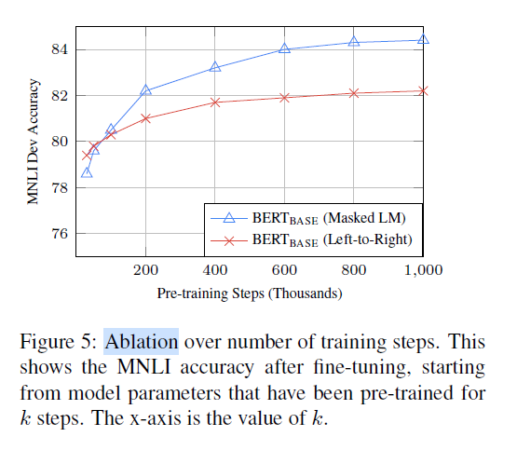
Different Masking Procedures
Comparison between Masked LM and Left to right Approach
High accuracies with masking
Masking rates changed:
Surprisingly robust to different masking strategies.
Even for Random rate, results are not bad

Slide 41
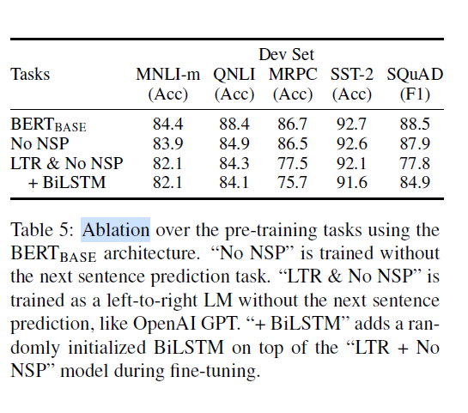
Ablation studies on MTM and NSP
No NSP
Heavy accuracy drop in QNLI
Other accuracies drop ~1%
LTR and No NSP:
Using LTR instead of MTM.
Heavy drop in Squad. Intuitive as token level hidden states have no right-side context.
Adding BiLSTM:
Better results for SQUAD but not as good as when using MTM and NSP
All models give better results with BERT!

Slide 42
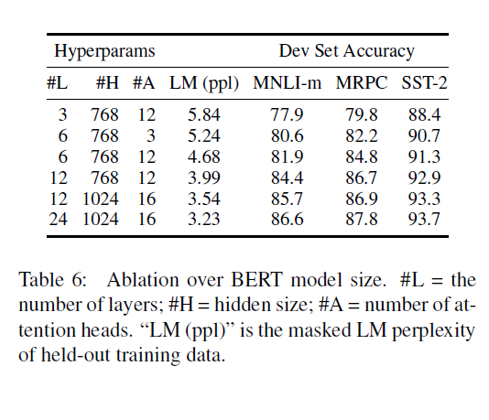
Effect of model size on fine tuning accuracy
Larger models lead to a strict accuracy improvement
Accuracies improve even for MRPC which only has 3,600 labeled training examples
Scaling to extreme model size leads to large improvements not only in large scale tasks but also small scale tasks
Hypothesis: Fine tuning directly to downstream tasks improves with model size increase

Slide 43
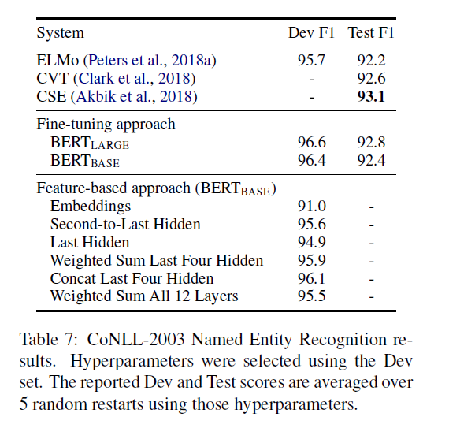
Feature Based Approach
Can extract features/activations from one or more layers and pass it to your network.
From graph – concat last 4 layer hidden gives 96.1
Slightly less than BERT Base and BERT Large
Demonstrates that BERT is effective for both fine tuning and feature based approaches

Slide 44
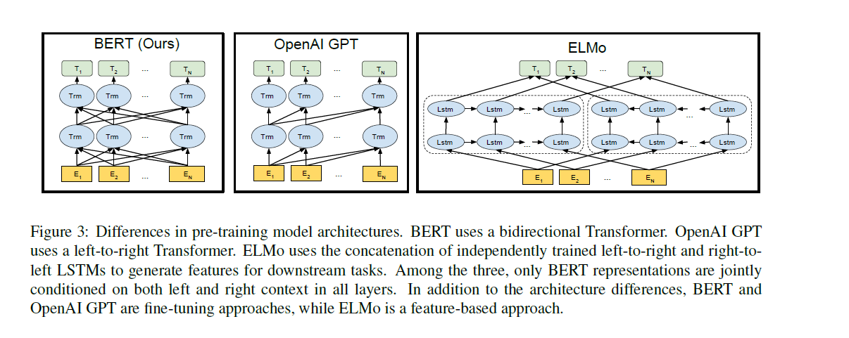
Better than similar approaches BERT vs OpenAI GPT vs ELMo
OpenAI GPT:
Left to Right Transformer
Follows Fine tuning Approach
Only left context visible
ELMo
Independently trained left to right and right to left LSTMs
Feature Based Approach
Left context and right contexts visible but independently.
BERT
MTMs and NSPs
Follows Fine tuning Approach
Entire context visible at the same time

Slide 45
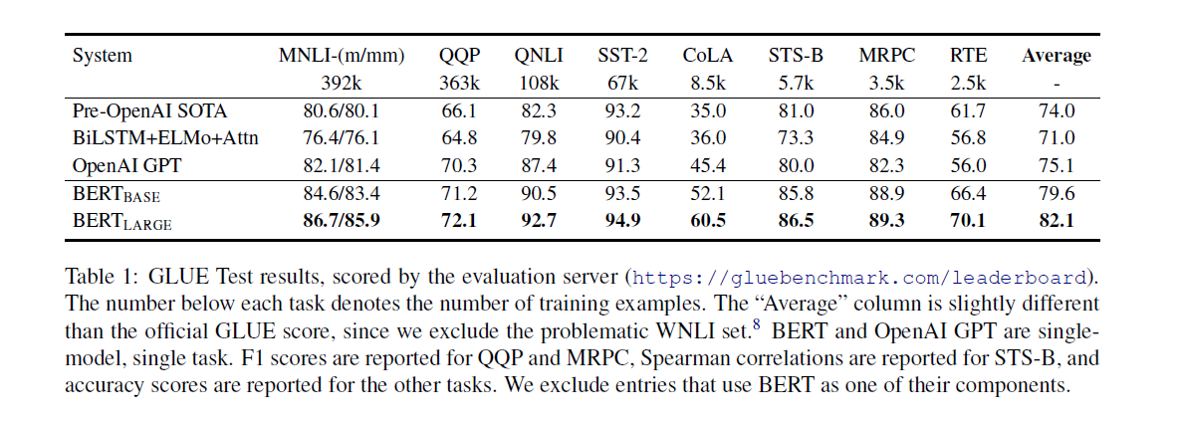
Comparison of Results

Slide 46
References
BERT: Pre-training of Deep Bidirectional Transformers for Language Understanding (Jacob Devlin Ming-Wei Chang Kenton Lee Kristina Toutanova)
https://arxiv.org/pdf/1810.04805
Paper Dissected: “BERT: Pre-training of Deep Bidirectional Transformers for Language Understanding” Explained (keitakurita)
https://mlexplained.com/2019/01/07/paper-dissected-bert-pre-training-of-deep-bidirectional-transformers-for-language-understanding-explained/
Understanding searches better than ever before (Pandu Nayak)
https://www.blog.google/products/search/search-language-understanding-bert/
BERT
https://github.com/google-research/bert
How the Embedding Layers in BERT Were Implemented
https://medium.com/@_init_/why-bert-has-3-embedding-layers-and-their-implementation-details-9c261108e28a
Transformer (machine learning model)
https://en.wikipedia.org/wiki/Transformer_(machine_learning_model)
The Illustrated Transformer (Jay Alammar)
http://jalammar.github.io/illustrated-transformer/
How do Transformers Work in NLP? A Guide to the Latest State-of-the-Art Models (Prateek Joshi)
https://www.analyticsvidhya.com/blog/2019/06/understanding-transformers-nlp-state-of-the-art-models/
BERT (language model)
https://en.wikipedia.org/wiki/BERT_(language_model)
Video: BERT: Pre-training of Deep Bidirectional Transformers for Language Understanding (Yannic Kilcher)
https://www.youtube.com/watch?v=-9evrZnBorM&t=2089s

Slide 47
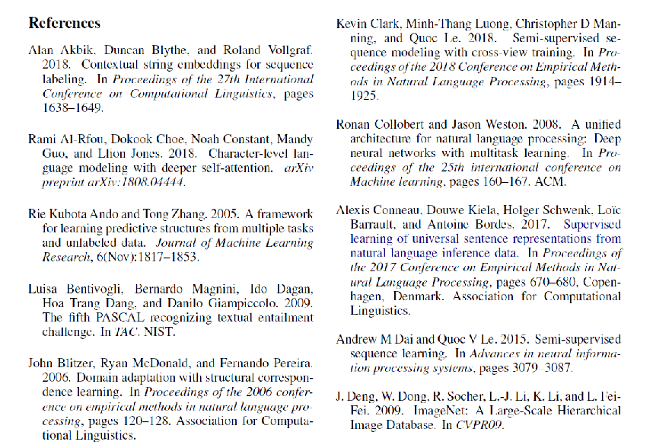
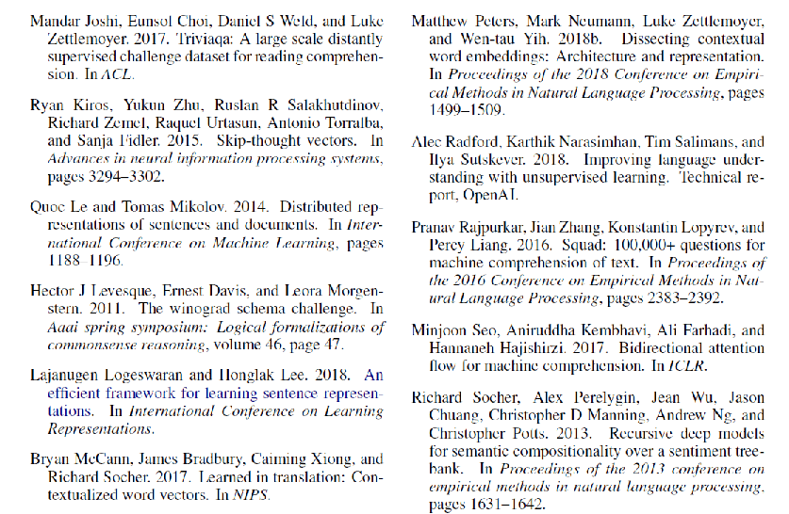
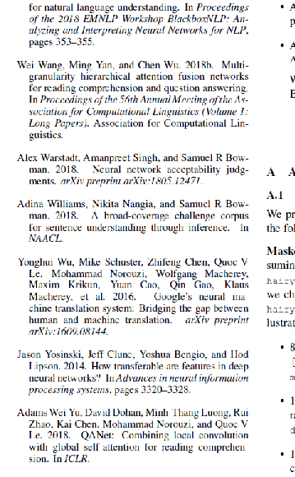
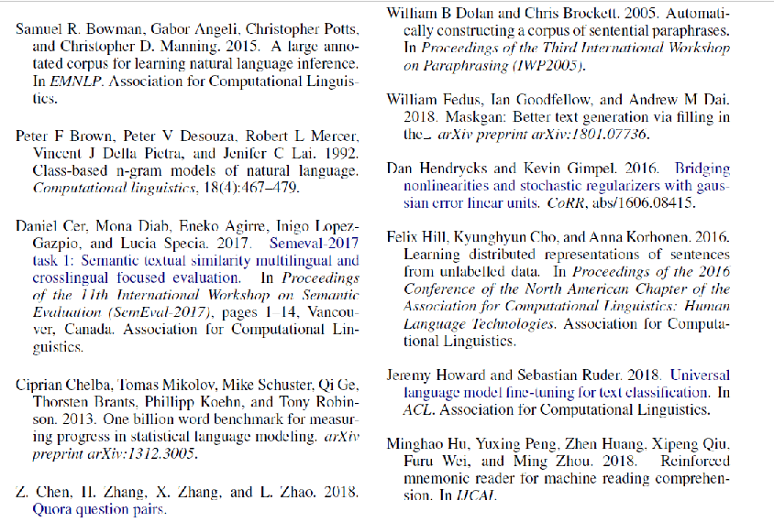
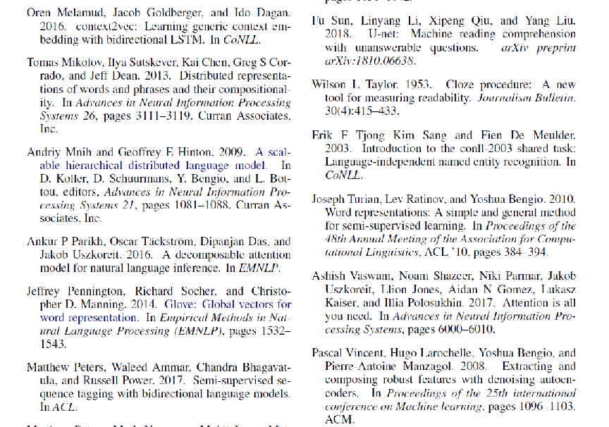
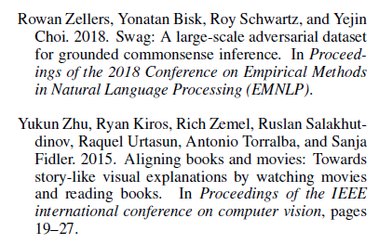
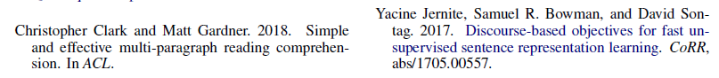
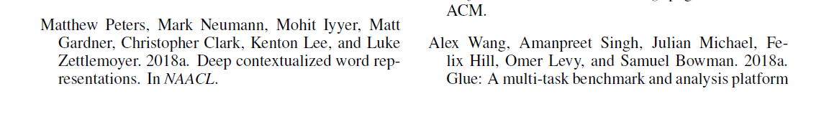

Slide 48
Any Questions

Slide 49
Thank you!

